Slide 1
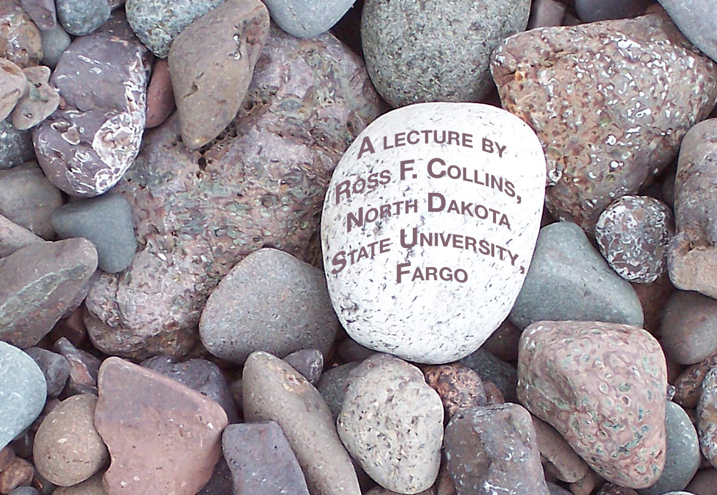
History
of photography and the mass media

Slide 2
Beginnings
Non-fiction photography to report news began soon after the invention of photography in 1839.
Despite the bulky 19th century processes, photographers were able to capture wars, fires, accidents and other news-style events.

Slide 3
War photography
Roger Fenton’s work from the Crimean War in 1855, is considered one of the first attempts to capture images based on current events.

Slide 4
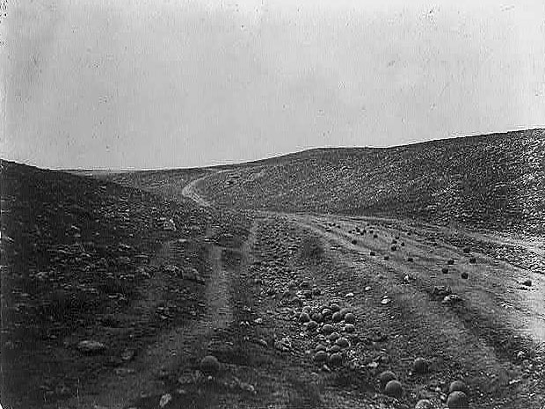
Early war photography
“Valley in the Shadow of Death” is Fenton’s most famous photo from that time.

Slide 5
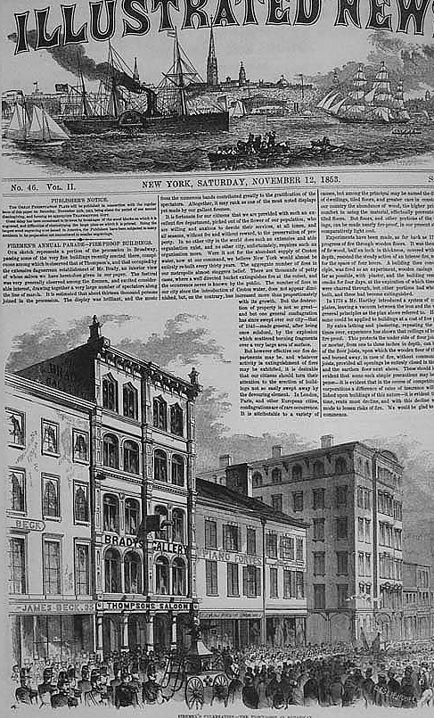
U.S. Civil War
Mathew Brady, a famous New York studio photographer, conceived an immense plan to photo the entire U.S. Civil War, 1861-1865.

Slide 6
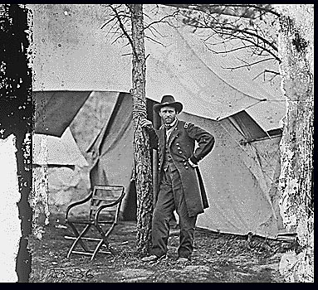
Brady Civil War photos
Most of what we know visually from that war came from Brady’s photo team.

Slide 7
Engraving
But until the 20th century, news photos could not be printed directly.
Artists had to meticulously hand-copy them as engravings.
Engravings were good, but not actual photos.

Slide 8
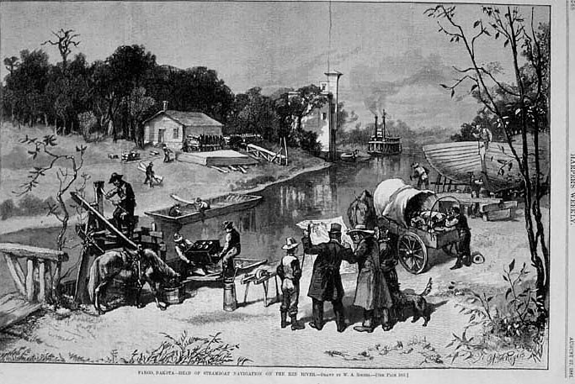
Fargo, 1881
This engraving based on a photograph, probably, depicts the Red River in Fargo in 1881. (Harper’s Weekly.)

Slide 9
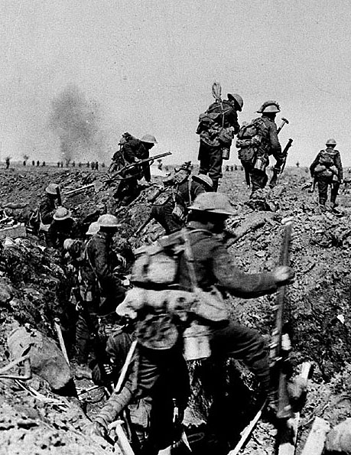
Modern news photos
By the beginning of the 20th century it was possible to print photos directly using the halftone method.
World War I in particular was heavily photographed.

Slide 10
Mass media photography as a concept
But “photojournalism” as a story-telling concept didn’t exist. Photos were displayed singly, or in the style of a photo album, all the same size.
One reasons was that cameras were still cumbersome; candid photography was difficult.

Slide 11
35mm format
The first technological change to make photojournalism possible was the invention of a small, fast-working camera.
Instead of the large-format film of the day, the Leica used left over movie film in smaller, 35mm format.

Slide 12
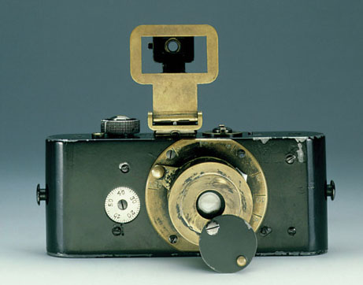
Leica
The Leica allowed news photographers to work unobtrusively, without bulky tripods or big cameras.
They could finally shoot natural, unmanipulated photos showing how people really lived.

Slide 13
Photojournalism magazines
About the same time another new development advanced the modern idea of story-telling photography: the photojournalism magazine.

Slide 14
Early developments
Photo-based magazines were not new; they were launched at the beginning of the 20th century, when it became possible to print photos directly.

Slide 15
Photo magazines
The idea of combining the story-telling techniques of journalism with photography actually originated in Germany.
German publishers as early as the 1920s experimented with the photo magazine idea.

Slide 16
Photo story develoment
The concept involved using primarily photos, along with cutlines, to tell a story visually.
Photographers would begin by shooting many more photos than needed.
Editors would examine these photos based on contact sheets—miniature photos that today we see using Bridge software.

Slide 17
Photo story
Editors would choose the photos they felt best told the story.
Also important were words, mostly cutlines.
The photos would not be printed all the same size, but instead would help guide a reader through a photo story through size differences and placement.
This meant graphic artists also were important. Photos were not just placed as in an album.

Slide 18
Dominant photo
One dominant, theme-setting photo would be published larger, to help define the story.
Copy would be kept to a minimum.
This was a combination of photography and journalism. The term “photojournalism” actually was coined by a historian, Frank Luther Mott, in the 1940s.

Slide 19
America’s photojournalism
After Hitler’s rise to power in 1933 most of these pioneering German photo editors were persecuted, their publications suppressed.
Many fled the country, often to the United States. The photojournalism idea moved by the 1930s to America.

Slide 20
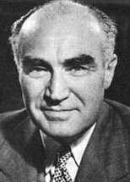
Henry Luce
Henry Luce had already become a prominant publisher after launching Time and Fortune, two large-circulation magazines.
He conceived of a general-interest magazine developed to reflect modern photojournalism ideas.

Slide 21
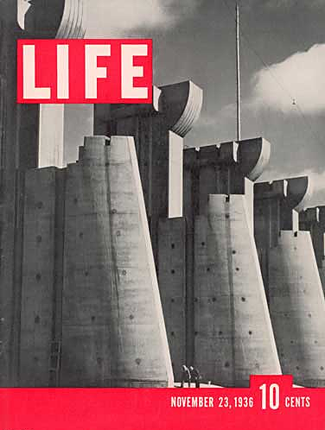
Life magazine
That magazine, launched Nov. 23, 1936, was called Life.

Slide 22
Margaret Bourke-White
Cover story of the first issue considerd the building of the Fort Peck dam in Montana.
Margaret Bourke-White’s photos showed the frontier style of existence lived by the workers and rural towns surrounding this massive building project.
It captured Americans’ imagination of a frontier life thought long gone. Life, published weekly, saw circulation soar.

Slide 23
Life’s success
By World War II, Life was the most influential magazine in America, probably in the world. Many magazines emulated its approach with such titles as Look, See, Photo, Picture and Click.

Slide 24
Dominance of Life
World War II, breaking out in 1939, assured dominance of Life as publication of record for war photography.
The most famous and dramatic photojournalism of that war was published most often in weekly magazines such as Life, and less often in newspapers.

Slide 25
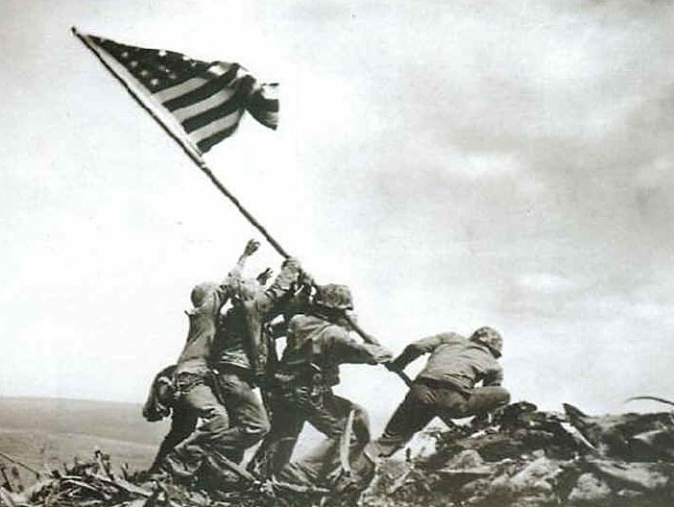
World War II
The drama and violence of war could be captured as never before (photo by Joe Rosenthal).

Slide 26
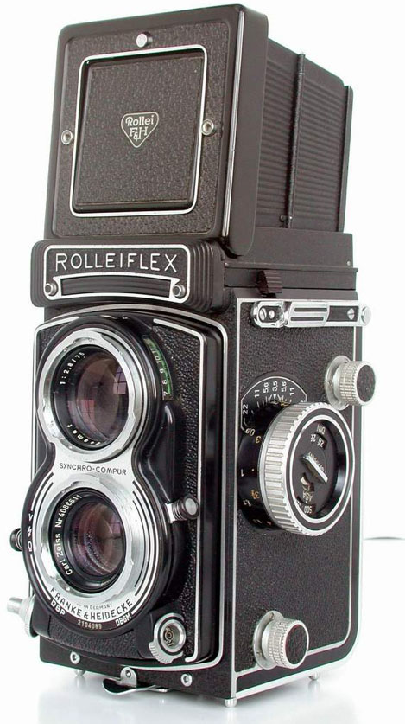
News camera formats
While 35mm became popular among photojournalists in the 1930s, it did not grow to dominate the media until the 1960s.
Before this, many newspaper photographers used the 120 film format. The Rolleiflex was most popular.

Slide 27
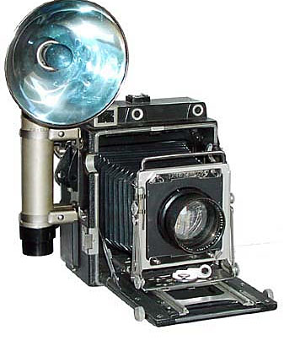
Speed graphic
Of course, some photojournalists, particularly newspaper photographers, continued to use the old Speed Graphic.
When we think of photojournalists from the past, we picture them using this camera.

Slide 28
Large-format negatives
Cameras like the Rolleiflex and Speed Graphic were clunky. But they had one big advantage: a large negative.
35mm cameras had, of course, 35mm negatives. In contrast, a Speed Graphic’s negative was about 2 inches by 3 inches.
In darkrooom days this kind of negative would produce a decent print even if the photographer made all kinds of focus or exposure mistakes.

Slide 29
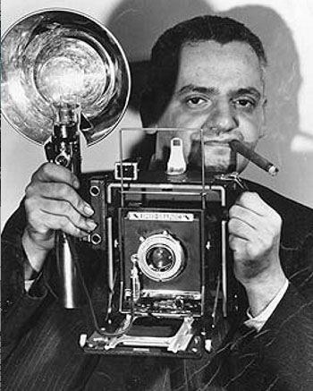
Weegee
Great photojournalists of the early era included Arthur Fellig, who went by the name Weegee.
He was the tough cigar-chomping cameraman who took photos of New York murders and gritty street scenes.
He became the cliché for early newspaper photojournalism.

Slide 30
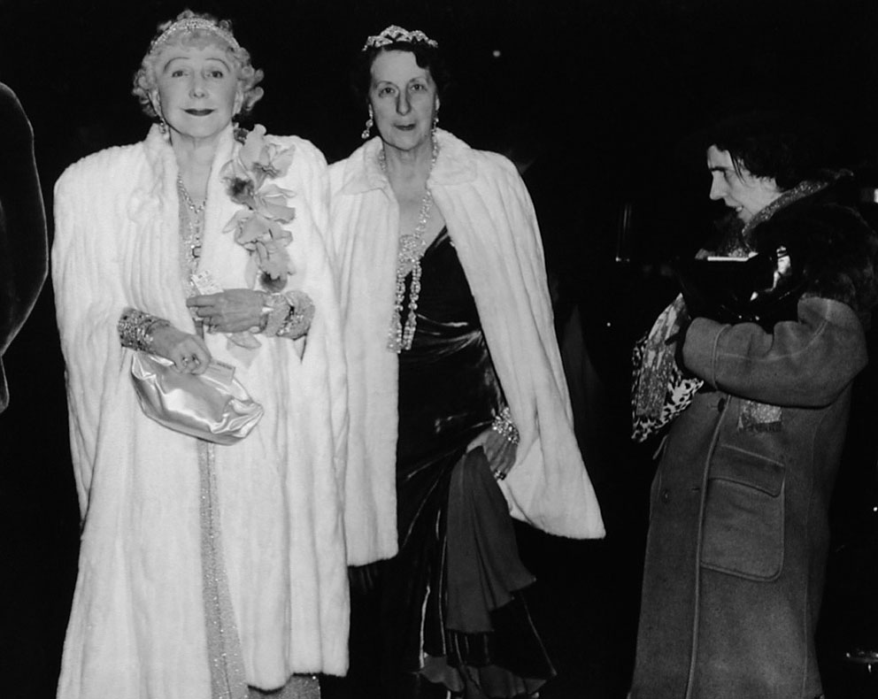
Weegee
Probably Weegee’s most famous photo is this social commentary taken during the Great Depression.

Slide 31
Capa and Smith
Among most famous World War II photojournalists were Robert Capa and W. Eugene Smith.

Slide 32
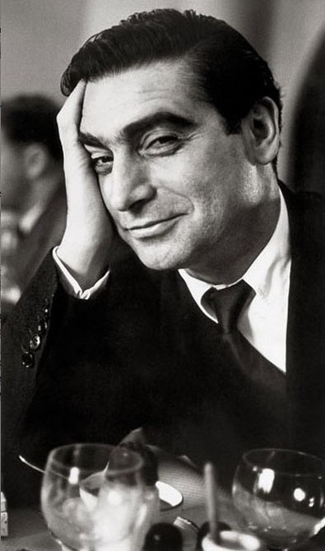
Robert Capa
Capa recorded the Spanish Civil War (1936-39) before moving on to World War II and Vietnam.
He died stepping on a mine while photographing war in Indochina.

Slide 33
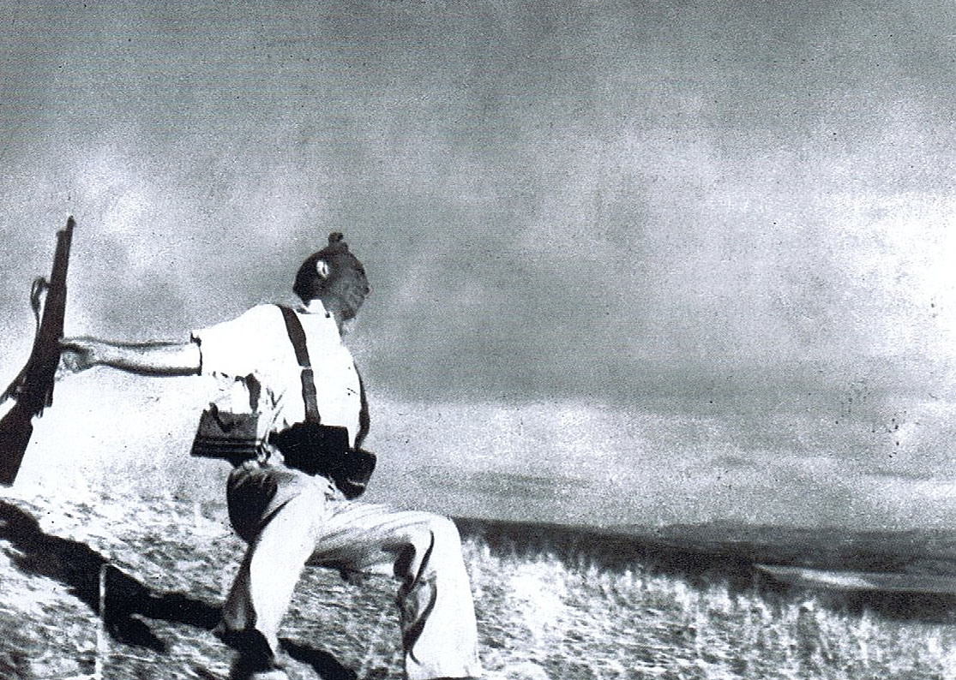
Robert Capa
Capa’s most famous image is of a Spanish soldier at the moment of death.

Slide 34
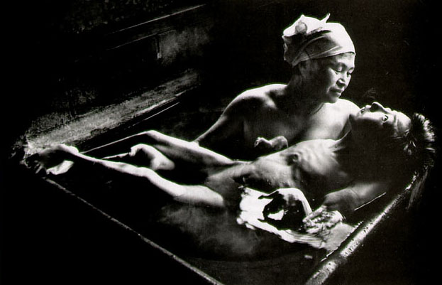
W. Eugene Smith
Smith was severely injured in Japan. He was attacked by thugs as he tried to document the birth defects based on industrial pollution there.

Slide 35
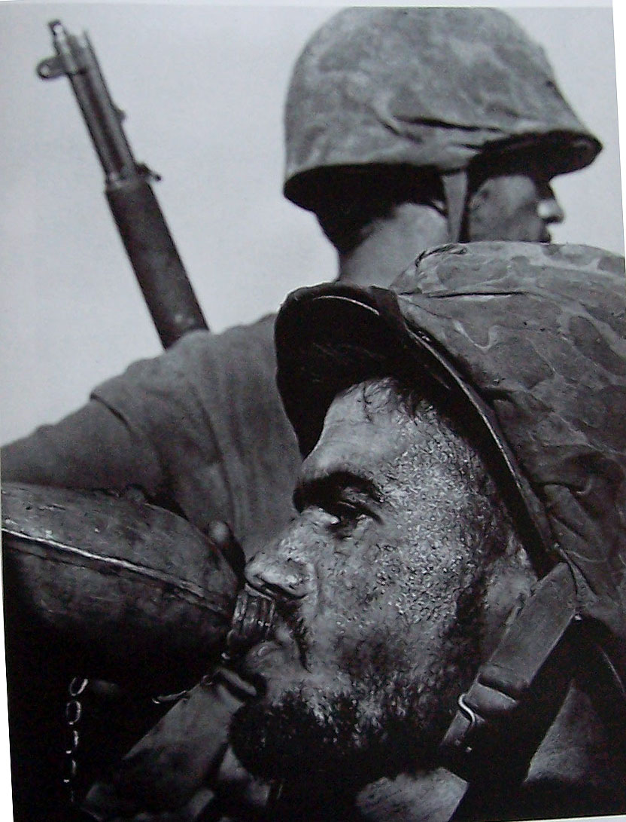
Smith war photography
Smith was one of Life’s most well-known war photographers, although he later quit to become part of the most most famous photojournalist agency of all time, Magnum Photo.

Slide 36
FSA documentary
Shortly before the war, the U.S. Government realized the power of photojournalism to tell a story visually.
The Farm Security Administration was set up in 1935 to help resettle farmers devastated by drought and depression.

Slide 37
FSA documentary
Roy Stryker, the director, realized the agency’s policies might be controversial.
He hired a team of photographers to record the destitution of Midwestern farmers during this period.

Slide 38
FSA documentary
Some of the country’s most famous photographers worked for the FSA. They produced 150,000 images, all available today through the Library of Congress.

Slide 39
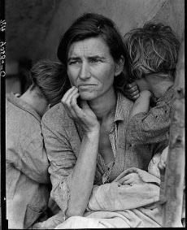
FSA images
Among the most famous FSA-produced images is Dorthea Lange’s “Migrant Mother.”

Slide 40
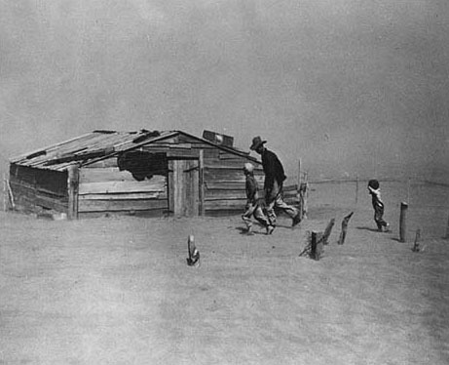
FSA images
Also famous is Arthur Rothstein’s dust bowl photo.

Slide 41
Golden age of photojournalism
The golden age of photojournalism lasted from about 1935 to 1975.
Television had a huge impact. The big photojournalism magazines found it hard to compete.
Life magazine ceased publication as a weekly in 1972. It has since come back as a monthly, then as special issues, over the years.

Slide 42
Power of still
Video’s ability to show things with movement and sound in many ways was more powerful than still photos.
Even so, many of the images symbolic of a time, a place or an event are still photos, not videos.

Slide 43
Changes to photojournalism
When I began as a photojournalist, newspapers were still publishing whole photo pages, with minimal text, and mostly black-and-white pictures.
In the 1980s this seemed to begin to change.

Slide 44
Photography as design element
Photo stories standing alone, telling the story with bare cutlines, often gave way to more artistic solutions to telling a story.
Photos more often became tools in an overall design, along with drawings, graphics, and other elements.

Slide 45
Digital change
But it seems the ascent of digital photography in the late 1990s has encouraged more people to be interested in taking pictures.
Today we are awash in photos, many of them bad. But it does seem photojournalism may see a rebirth on the Web, where stories can be told visually as well—though perhaps in a different way.

Slide 46
Technology
Many photojournalists were shocked by the rapid change from film to digital imaging. But photography has always been technology-driven.

Slide 47
Technology
Photography at is essence is built around machines.
Until recently is was also built around chemistry.
And it now is built around programming.

Slide 48
Color
Color photography, for example, used to be impossible to produce.
By the 20th century, it was possible, but difficult.
By the end of World War II, it was not as difficult, but very expensive.
By the 1990s it was standard, although still somewhat costly.
Today it is standard on the Web, but still costs more in print on offset presses.

Slide 49
Color and B & W
Some photojournalists think photos are often stronger in black and white, because they don’t have the distraction of color.
Others think color photography better captures the way the world is. We don’t see in black and white.
Color does attract attention, and photojournalists know that. That’s why they’ll look for subjects wearing red.

Slide 50
Quality improvements
Quality of photojournalism seems to have increased. Cameras are a lot smarter, and mistakes can be corrected using software like Photoshop.
That said, are news pictures better today than they used to be? The answer isn’t obvious.

Slide 51
Quiality vs. candid
For example, color photography demands better lighting. Many photojournalists have responded by setting up more elaborate artificial lighting.
But when you set up lighting, you are manipulating the spontaneity of candid photography, the “slice of life” photography that defines good photojournalism.
More photojournalists seem to prefer posed photos over candid photos today, perhaps because the color and quality can be better controlled.

